Slide 1
Counting 101
addition and multiplication

Slide 2
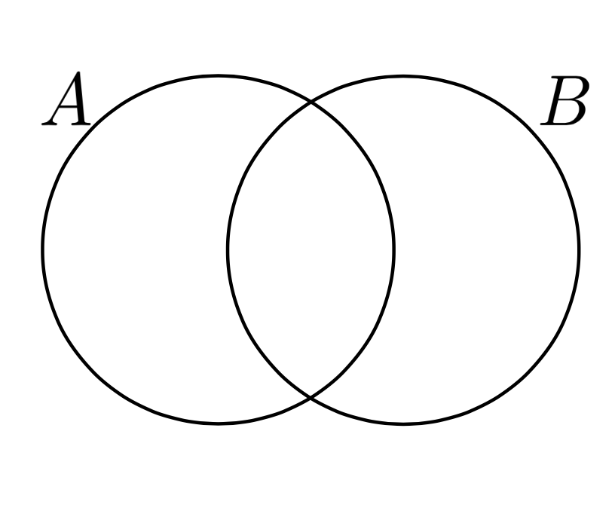
(Recall) Cardinality Adding!

Slide 3
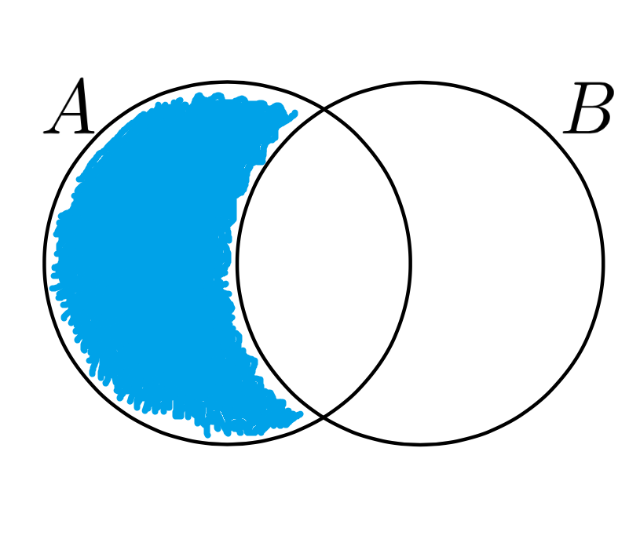
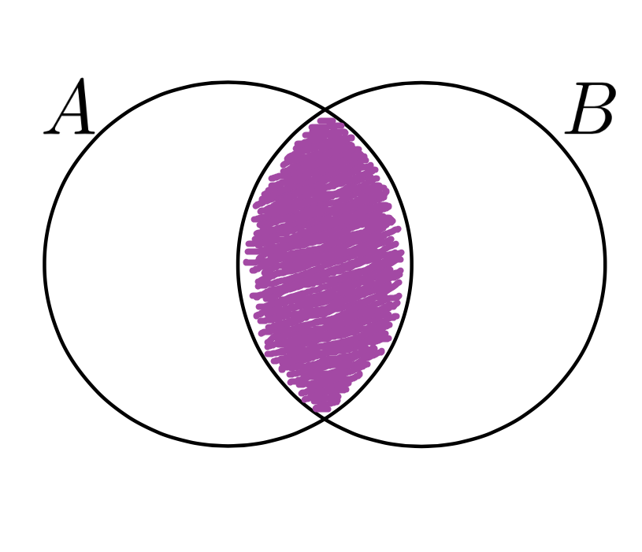
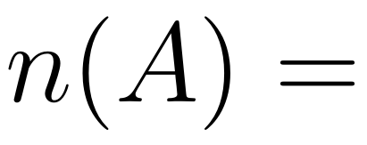
(Recall) Cardinality Adding!

Slide 4
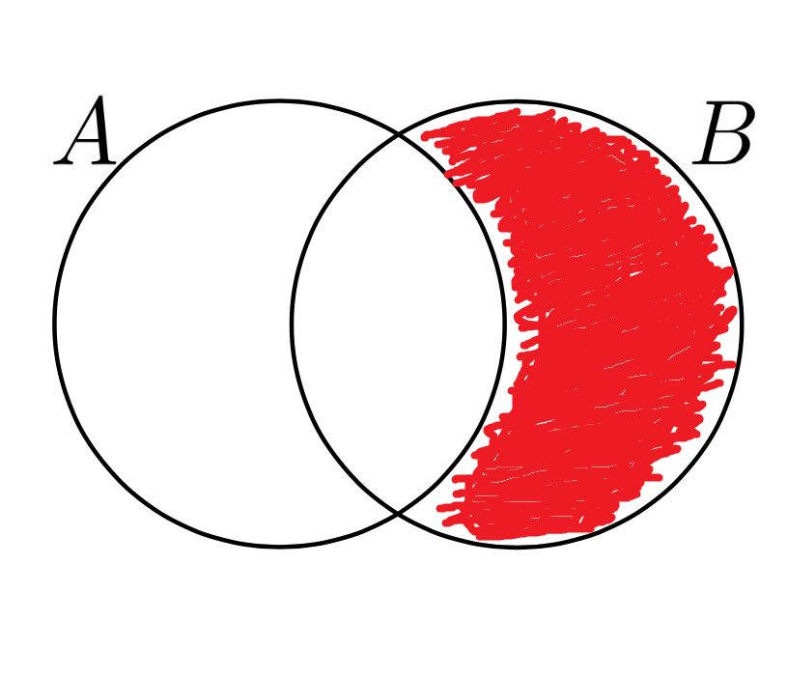
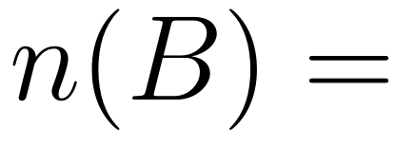
(Recall) Cardinality Adding!

Slide 5
(Recall) Cardinality Adding!

Slide 6
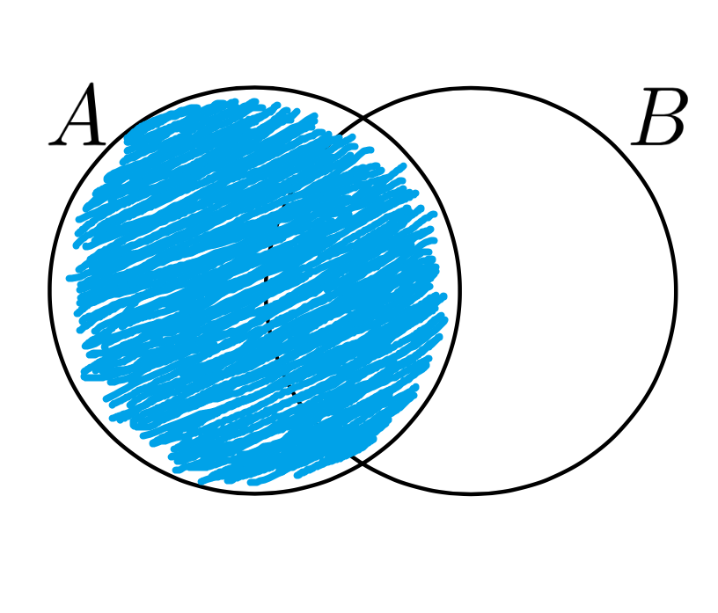
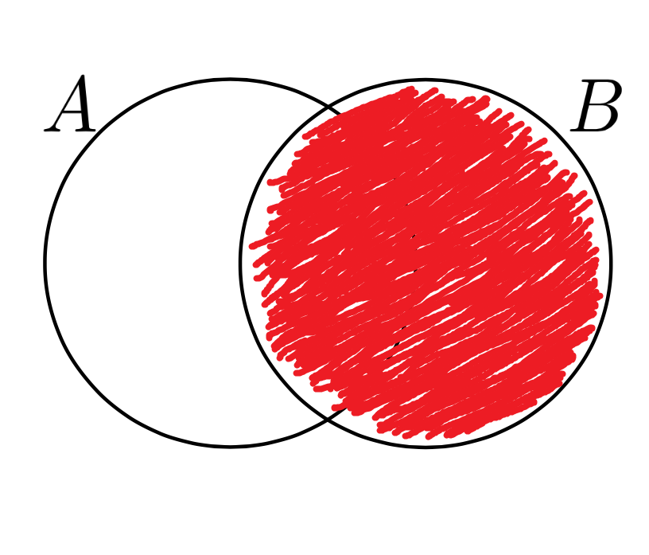
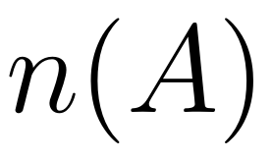
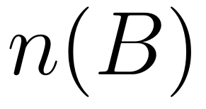
(Recall) Cardinality Adding!

Slide 7
(Recall) Cardinality Adding!

Slide 8
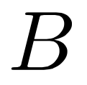
Disjoint Unions...
it means they are different
(that is they have an empty intersection)

Slide 9
Sum of Disjoint Unions (The Addition Rule)

Slide 10
The addition rule...
Example:
Rob’s Restaurant on 5-points, has 3 chicken dishes, 4 steak dishes, and 3 fish dishes.
How many dishes does Rob’s Restaurant have?

Slide 11
The addition rule...
3
4
3
=10

Slide 12
(Recall) Cross Products!

Slide 13
(Recall) Cross Products!
we can do this any number of times

Slide 14
(Recall) Cross Products!
we can do this any number of times

Slide 15
The multiplication rule…(cross products)
Example:
At Rob’s Restaurant, we have the choice of 3 appetizers, 10 main dishes, and 2 desserts.
How many different meals (an appetizer, a main dish, and a dessert) can you get?

Slide 16
The multiplication rule…(cross products)

Slide 17
The multiplication rule…(cross products)
So what set would represent a meal?
for example one meal is:
(Cheese Sticks, Fried Chicken, Cheese Cake)

Slide 18
The multiplication rule…(cross products)

Slide 19
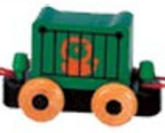
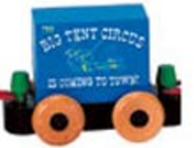
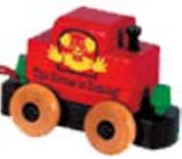
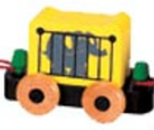
The multiplication rule… (trains)
My Trains =

Slide 20
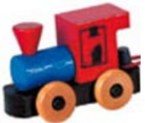
The multiplication rule… (trains)
Possible Trains:
Is this a cross product?

Slide 21
The multiplication rule… (trains)
…

Slide 22
The multiplication rule… (trains)
How could we count this?
1st Choice
2nd Choice
3rd Choice
4th Choice

Slide 23
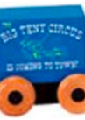
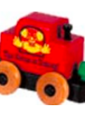
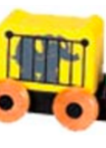
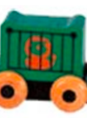
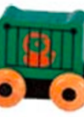
The multiplication rule… (trains)
1st
2nd
3rd
4th
4
x
3
x
2
x
1
= 24

Slide 24
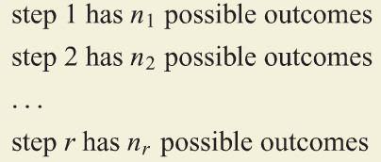
The multiplication rule…(general)
In general the multiplication rule is:
if we have:
What does this mean?
then there are

Slide 25
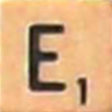
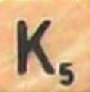
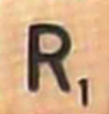
The multiplication rule...

Slide 26
The multiplication rule… Breaks?
WE COULD MAKE THE MISTAKE:
4 choices
3 choices
2 choices
1
choice
(4) x (3) x (2) x (1) =24

Slide 27
The multiplication rule… Breaks?
are these DISTINCT?
1st Choice
2nd Choice
3rd Choice
4th Choice

Slide 28
The multiplication rule… fixed!
How could we count this?
K’s Choice
R’s Choice
E’s Choice

Slide 29
The multiplication rule… fixed!
How could we count this?
K’s Choice
R’s Choice
E’s Choice
4
x
3
x
1
= 12

Slide 30
Group Work:

Slide 31
Counting 201
permutations and combinations

Slide 32
Permutations… (trains again)
My Trains =

Slide 33
Permutations… (trains again)
Possible Trains: (permutations of the train cars)
1st
2nd
3rd
4th
4! =
4
x
3
x
2
x
1
= 24

Slide 34
Factorial...

Slide 35
Permutations

Slide 36
Permutations

Slide 37
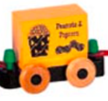
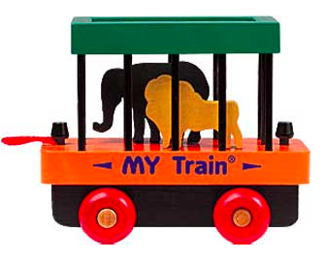
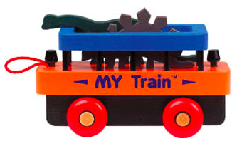
Permutations… (mo’ trains)
7 train cars!
My Trains =
(only 4 at a time)

Slide 38
Permutations… (mo’ trains)
Possible Trains: (permutations of the 4 train cars)
How could we count this?

Slide 39
Permutations… (mo’ trains)
(first attempt)
Multiplication Rule to the Rescue!
1st
2nd
3rd
4th
7
x
6
x
5
x
4
= 840

Slide 40
Permutations… (mo’ trains)
(second attempt)
Over Counting!
(what if we were counting permutations of all 7? )
7!
= 5040
how many extra did we count?

Slide 41
Permutations… (mo’ trains)
(second attempt)
Over Counting!
3! = 6

Slide 42
Permutations… (mo’ trains)
(second attempt)
Over Counting!
7!
= 840
3!

Slide 43
Permutations… (general trains)
n
Over Counting!
...
...
...
...
(n-r)
r

Slide 44
Permutations… (general)
If we have n things that we want to take r things at a time
n!
(n-r)!

Slide 45
Permutations… (general)

Slide 46
Permutations… (general)

Slide 47
Combinations...
To permute a list is to change the ORDER!
In contrast a combination is just a sub collection of items with no order (a subset)

Slide 48
Combinations…
Example: (how to play)
You first choose 5 different numbers (the white balls) from 1 to 69. Then you pick the Powerball (the red ball) from 1 to 26. The order which you pick the numbers for the white balls is irrelevant. If your 5 numbers + 1 powerball number match the 5 numbers + 1 powerball drawn in the “official drawing” you win! If you wanted to buy tickets that cover every possible combination (guaranteeing a win), how many tickets would you need to buy?

Slide 49
Combinations…
(We will count the white balls first)
(over counting again!)
What if we tried counting the permutations?

Slide 50
Combinations…
(We will count the white balls first)
(over counting again!)
12
9
22
11
47
9
12
47
22
11

Slide 51
Combinations…
(We will count the white balls first)
(over counting again!)
(How many different ways could this happen?)
12
9
22
11
47
5! = 120

Slide 52
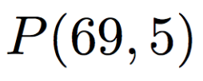
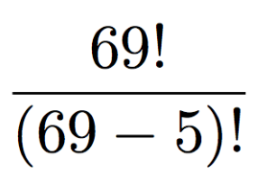
Combinations…
White Balls=
=
= 112385
5!
5!
Finish up with good old multiplication Rule!
112385 x 26 = 292201338
White Balls
Power Ball

Slide 53
Combinations...

Slide 54
Combinations...

Slide 55
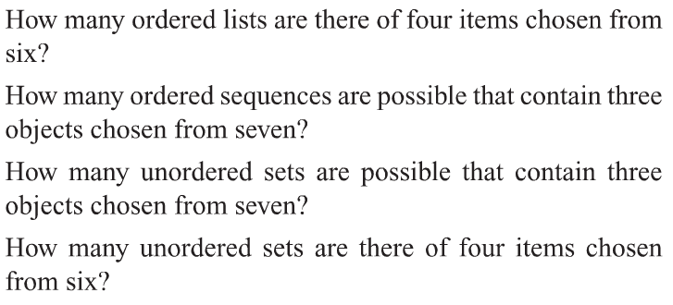
Group Work:

Slide 56
More Examples:
See the Blackboard for work

Slide 57
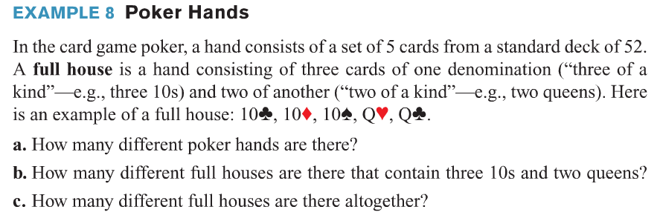
More Examples:
See the Blackboard for work

Slide 58
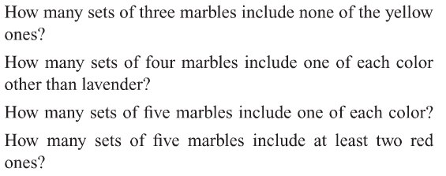
Group Work:

Slide 59
Group Work:

